Slide 1
Overview of
Professional Ethics, Key Standards and ‘Best Practices’
    Facilitator: Tishawah Pitter
MODULE 1

Slide 2
Introductions
Briefly introduce yourself and indicate your place of organization and what are your expectations of this course

Slide 3
Learning Objectives
At the end of the session the participant should be able to:
Explain the importance of applying and maintaining established standards for IT Audit.
Explain in detail the major standards and frameworks governing IT Audit
Outline the advantages and disadvantages of adopting an IT Audit standard or framework.
Apply established/international standards in IT Audit to their organisation.
Gain appreciation for the importance of and need for adherence to international standards and good practice.
Notes:
At the end of this module participants should be able to :

Slide 4
Importance of applying and maintaining standards
They ensure consistency of approach while scoping, planning, executing and following up on IT audits.
Adoption of best practice standards enhances the reputation of the audit function in the organization and audit ‘clients’ are reassured by the reliable, relevant and best practice audit approach.
They avoid re-inventing the wheel. The auditor is reassured that the best practice guidance has been ‘tried and tested’ through the audit world and will set minimum benchmarks for good audit practice.
High risk areas are given priority as the standards enforce a risk-based approach to audit.

Slide 5
Getting to know ISACA
Information Systems Audit and Control Associations (ISACA).

Slide 6
Examples of Standards, Guidelines and Good Practices Governing Information Systems
IT Governance Institute (ITGI) – is the leading reference on IT governance for the global business community. ISACA formed the ITGI to focus on original research on IT governance and related topics. ITGI has developed COBit and Val IT frameworks and also offers original research and cases studies. See (www.itgi.org)
Control Objectives for Information and Related Technology (COBIT) – IT Governance Framework.
Value from IT investments (Val IT) – is a framework that outlines governance best practices for information technology-enabled business investments.
Notes:
These guidance documents provide the basis on which auditors are able to evaluate the IS environment.

Slide 7
Examples of Standards, Guidelines and Good Practices Governing Information Systems
Information Technology Assurance Framework (ITAF) – ITAF applies to individuals who act in the capacity of IS audit and assurance professionals and are engaged in providing assurance over some components of IT systems, applications and infrastructure.

Slide 8
Examples of Standards, Guidelines and Good Practices Governing Information Systems
Global Technology Audit Guides (GTAGs) – Specific guidance for auditing IS areas.
SYSTRUST and WEBTRUST - e-commerce, e-business and systems
ISO27001 – IT Security
ISO27002 – IT General Controls
Information Technology Infrastructure Library (ITIL) – IT Service Management
Prince 2 – Project Management Framework

Slide 9

Professional Ethics
Ethics is known as a moral philosophy. It addresses the question of behavioural conduct, intentions, decisions, and actions between those that are good (right) and those that are bad (wrong).
As IT Auditors we have to abide by a specific code while undertaking our work. Why do you think this is necessary?
Notes:
The important point here is that there should be (and is) no conflict between the ISACA Code of Professional Ethics and any other properly formulated Code of Ethics for audit. Key areas or behaviours remain the same e.g. objectivity, due diligence and professional care, in accordance with professional standards, Maintain the privacy and confidentiality of information, etc.

Slide 10
ISACA Code of Professional Ethics
IT Auditors shall:
Support the implementation of, and encourage compliance with, appropriate standards, procedures and controls for information systems.
Perform their duties with objectivity, due diligence and professional care, in accordance with professional standards and best practices.
Serve in the interest of stakeholders in a lawful and honest manner, while maintaining high standards of conduct and character, and not engage in acts discreditable to the profession.
Maintain the privacy and confidentiality of information obtained in the course of their duties unless disclosure is required by legal authority. Such information shall not be used for personal benefit or released to inappropriate parties.
Notes:
ISACA sets forth this Code of Professional Ethics to guide the professional and personal conduct of members of the Association and/or its certification holders.
Failure to comply with this Code of Professional Ethics can result in an investigation into a member’s or certification holder’s conduct and, ultimately, in disciplinary measures.

Slide 11
ISACA Code of Professional Ethics
Maintain competency in their respective fields
Support the professional education of stakeholders in enhancing their understanding in the governance and management of enterprise information systems and technology.

Slide 12
Discussion
Is there any difference between the ISACA code of ethics and the Institute of Internal Auditors Code of Ethics?

Slide 13
Information Technology Assurance Framework “ITAF: A Professional Practices Framework for IT Assurance”
The specialised nature of information systems (IS) audit and assurance and the skills necessary to perform such engagements require standards that apply specifically to IS audit and assurance. The development and dissemination of the IS audit and assurance standards are a cornerstone of the ISACA professional contribution to the audit community.
This is a key ISACA initiative that provides a single point of reference for IT Auditors and ensures quality, consistency and reliability of the audit approach.

Slide 14
Information Technology Assurance Framework “ITAF: A Professional Practices Framework for IT Assurance”
The ITAF is useful to IT auditors and assurance professionals who are engaged in providing assurance over some components of IT systems, applications and infrastructure.
It is a ‘living’ document in the sense that it reflects the current ISACA and IT Governance Institute concepts eg. COBIT guidelines. ITAF is usually updated as new standards and guidelines emerge. The framework has been designed specifically with IT audit and assurance in mind.

Slide 15
Purpose of the ITAF
The ITAF has a number of key objectives:
To provide guidance on the design, conduct and reporting of IT audit and assurance assignments
To define terms and concepts specific to IT assurance
To establish standards that address IT audit and assurance professional roles and responsibilities, knowledge and skills, diligence, conduct and reporting requirements
Available for PDF download at http://www.isaca.org/Knowledge-Center/ITAF-IT-Assurance-Audit-/Pages/default.aspx

Slide 16
Information Technology Assurance Framework (ITAF)
Standards - adherence to these is mandatory for IS audit and assurance requirements.They provide the IT/IS Audit and Assurance professional with benchmarks for a minimum level of acceptable performance required to meet the relevant professional responsibilities.
Guidelines - provides further information on how to apply the standards.
Tools and Techniques - in the form of supplementary procedures.
Currently, there are 17 Standards, 18 Guidelines and five categories of Tools and Techniques. All are available on the ISACA website www.isaca.org

Slide 17
Key components of the ITAF are standards, guidelines, tools and techniques
General Standards (1000 series) - Are the guiding principles under which the IS assurance profession operates. They apply to the conduct of all assignments, and deal with the IS audit and assurance professional’s ethics, independence, objectivity and due care as well as knowledge, competency and skill.
Performance Standards (1200 series)—Deal with the conduct of the assignment, such as planning and supervision, scoping, risk and materiality, resource mobilisation, supervision and assignment management, audit and assurance evidence, and the exercising of professional judgement and due care.
Reporting standards (1400 series)—Address the types of reports, means of communication and the information communicated.

Slide 18
Examples of Standards
1202.1
The IS audit and assurance function shall use an appropriate risk assessment approach and supporting methodology to develop the overall IS audit plan and determine priorities for the effective allocation of IS audit resources.
1202.2
IS audit and assurance professionals shall identify and assess risk relevant to the area under review, when planning individual engagements.
1202.3
IS audit and assurance professionals shall consider subject matter risk, audit risk and related exposure to the enterprise

Slide 19
Examples of Standards
1203.1
IS audit and assurance professionals shall conduct the work in accordance with the approved IS audit plan to cover identified risk and within the agreed-on schedule.
1203.2
IS audit and assurance professionals shall provide supervision to IS audit staff for whom they have supervisory responsibility, to accomplish audit objectives and meet applicable professional audit standards.
1203.3
IS audit and assurance professionals shall accept only tasks that are within their knowledge and skills or for which they have a reasonable expectation of either acquiring the skills during the engagement or achieving the task under supervision.
1203.4
IS audit and assurance professionals shall obtain sufficient and appropriate evidence to achieve the audit objectives. The audit findings and conclusions shall be supported by appropriate analysis and interpretation of this evidence.
1203.5
IS audit and assurance professionals shall document the audit process, describing the audit work and the audit evidence that supports findings and conclusions.
1203.6
IS audit and assurance professionals shall identify and conclude on findings.

Slide 20
Key components of the ITAF are standards, guidelines, tools and techniques
Guidelines, supporting the standards and are also divided into three categories :
General guidelines (2000 series)
Performance guidelines (2200 series)
Reporting guidelines (2400 series)

Slide 21
Key components of the ITAF are standards, guidelines, tools and techniques
Tools and techniques, providing additional guidance for IS audit and assurance professionals, e.g., white papers, IS audit/assurance programmes, the COBIT 5 family of products

Slide 22
Institute of Internal Auditors’ (IIA) Global Technology Audit Guides
The IIA Global Technology Audit Guides (GTAG) are comprehensive and designed to:
Provide a mechanism to quickly address new IT Issues.
Produce technical audit guides on a global scale.
Provide easy-to-understand information technology audit guides to members of the Audit profession.
See www.theiia.org/guidance/technology/

Slide 23
IIA Global Technology Audit Guides (GTAG)
GTAG 17: Auditing IT Governance​
GTAG 16: Data Analysis Technologies
GTAG 15: Information Security Governance ​​​
GTAG 14: Auditing User-developed Applications​ ​
GTAG 13: Fraud Prevention and Detection in an Automated World ​​
GTAG 12: Auditing IT Projects ​​
GTAG 11: Developing the IT Audit Plan ​​
GTAG 10: Business Continuity Management ​​
GTAG 9: Identity and Access Management ​​
GTAG 8: Auditing Application Controls
GTAG 7: Information Technology Outsourcing, 2nd Edition
GTAG 4: Management of IT Auditing, 2nd Edition
GTAG 3: Continuous Auditing: Implications for Assurance, Monitoring, and Risk Assessment
GTAG 2: Change and Patch Management Controls: Critical for Organizational Success, 2nd Edition ​​
GTAG 1: Information Technology Risk and Controls, 2nd Edition

Slide 24
TRUST SERVICES ASSURANCE
Trust Services are defined as a set of professional assurance services based on a common framework, which is comprised of a core set of principle and criteria. The framework has been designed to address the risk and opportunities associated with information technology.

Slide 25
SYS Trust and Web Trust Services
Jointly Developed by the American Institute of Certified Public Accountants (AICPA) and the Canadian Institute of Chartered Accountants (CICA).
In the development of these Trust Services, the objective was to establish a core set of principles and related criteria or control environments for key areas related to IT, e-commerce, e-business,and systems.

Slide 26
SYS Trust and Web Trust
These two services use the following Trust Services Principles and Criteria.
Security- The system is protected against unauthorised access(both physical and logical)
Availability- The system is available for operation and used as committed or agreed
Processing integrity- System processing is complete ,accurate ,timely and authorised.
Notes:
Security - ensuring that systems are protected against unauthorized access (both physical and logical).
Availability - ensuring that systems are available for operation and use as committed or agreed.
Processing integrity - ensuring that systems processing is complete, accurate, timely, and authorized.
Confidentiality - ensuring that Information that is designated as confidential is protected as committed or agreed.
Privacy - ensuring that personal information is collected, used, retained, and disclosed in conformity with the commitments in the entity’s privacy notice, any relevant legislation and the wider ‘Privacy Principles’ issued by the AICPA/CICA

Slide 27
SYS Trust and Web Trust Services
Confidentiality – information designated as confidential is protected as committed or agreed. Always a cornerstone of consumer trust-building, your work to protect business-to-business information is essential to the process. When your customers know that you have safeguards in place to protect their personal data from any type of intrusion, they are more likely to return for additional business transactions.
Online Privacy- Personal information obtained as a result of e-commerce is collected, used, disclosed, and retained as committed or agreed. Collecting personal data is an organic part of e-commerce and other online transactions. However, it takes a leap of faith for many customers to trust the process in the first place, but when they see news reports of hacking and stolen data, it is critical that you assure them that you do everything possible to protect their confidential information that they disclose to carry out transactions, per your mutual agreement.

Slide 28
SYS Trust and Web Trust Services
The Trust Services Principles and Criteria is essentially the merging and harmonization of the previous WebTrust and SysTrust Principles and Criteria. CPA firms can still perform a WebTrust or a SysTrust engagement using the Trust Services Principles and Criteria.

Slide 29
SYS Trust and Web Trust Services
Availability. Your system is available, according to commitments or agreements, for use and operation. It is important to regularly review the service levels outlined in your agreements with each of your online customers. Not only does this keep you in good standing with your customers, but it is also attractive to your Application Service Provider (ASP).
Processing Integrity.You have made sure that system processing is complete, accurate, timely, and properly authorized. Knowing that each transaction will go through successfully and safely is another attractive and confidence-building quality that customers appreciate and remember. Anything that buoys customers’ trust in the online buying experience adds to their likelihood of returning for additional business.
Confidentiality.
Privacy. Collecting personal data is an organic part of e-commerce and other online transactions. However, it takes a leap of faith for many customers to trust the process in the first place, but when they see news reports of hacking and stolen data, it is critical that you assure them that you do everything possible to protect their confidential information that they disclose to carry out transactions, per your mutual agreement.
Non-Repudiation. More of a benefit for your organization, non-repudiation still works to build mutual trust between you and your customers. Confirming customers’ ability to pay for online transactions helps protect your revenues, as well as your relationships with your customers.

Slide 30
A SysTrust engagement allows public accounting firms and practitioners to provide assurance on the reliability of a system using any of the Trust Services Principles and Criteria with the exception of the Online Privacy Principle and Criteria. The Online Privacy Principle and Criteria can only be used for a WebTrust engagement.
the SysTrust engagement “is designed to increase the comfort of management, customers, and business partners with systems that support a business or particular activity.”

Slide 31
SYS Trust and Web Trust Services
A SysTrust engagement brings focus to the following three pieces of information to help build consumer trust:
Integrity. Provide the best and most consistent system processing, making sure each transaction is complete, accurate, timely, and authorized.
Security. Keep your system safe by following the most current security trends to guard against any potential threat to your business’s system against various threats.
Availability. Monitor your agreement with your customer and always ensure that your system is available at the agreed service level.

Slide 32
SYS Trust and Web Trust Services
WebTrust uses several criteria to help evaluation the overall characteristics of a company’s online transaction environment.
IT leaders and outside auditors rely on the following criteria when performing evaluations:
Security. Your system is safe from all forms of unauthorized access, whether internal or external or physical or intellectual. Continually monitor the latest and most effective safety measures that you and your team can take to ensure optimal protection for your customers’ peace of mind, as well as your own.

Slide 33
Type of Engagement | IT Systems | eCommerce
Security | SysTrust | WebTrust
Privacy | - | WebTrust
Processing Integrity | SysTrust | WebTrust
Availability | SysTrust | WebTrust
Confidentiality | SysTrust | WebTrust
Certification Authorities | - | WebTrust
Consumer Protection | - | WebTrust
System Reliability | SysTrust | -
Other Engagement Combinations | SysTrust | WebTrust

Slide 34
EXERCISE

Slide 35
The IT Governance Institute (ITGI)
This organization was established in 1998 and is closely aligned with ISACA.
The ITGI is responsible for the ‘Control Objectives for Information Technology’ (COBIT) and Val IT frameworks - the current versions are 4.1, 5 and 2.0 respectively.
All IT Auditors should be aware of and understand the relevance of these frameworks in the context of audit and assurance work.

Slide 36
The Val IT Framework
ITGI developed the Val IT framework which, like COBIT, is a process-based model, in terms of realizing business value from IT investment and maximizing return-on-investment.
The IT Governance Institute produced two publications that IT Auditors can utilize. See “Enterprise Value: Governance of IT Investments - The Val IT Framework 2.0” July 2008 and “Value Management Guidance for Assurance Professionals: Using Val IT™ 2.0”, February 2010 both of which are available for download from http://www.isaca.org/KnowledgeCenter/Research/ResearchDeliverables/Pages/Val-IT-Framework-2.0.aspx

Slide 37
The Val IT Framework
What has been missing for many years has been ready access to a structured approach—a comprehensive structured framework based on proven practices—that can provide boards and executive management teams with practical guidance in making IT investment decisions and using IT to create organisational value.

Slide 38
The Val IT Framework
Val IT’s processes and practices are proven; they have been under development and in continuous use across leading enterprises for many years.
It helps executives understand and carry out the roles critical to managing IT investments, as well as the IT services and other IT assets or resources supporting or resulting from these investments

Slide 39
The Val IT Framework
This is an easy-to-follow guide on getting a value management initiative started.
It should also be noted that, although this publication is focused on IT-enabled investments, its content is applicable to all types of investment in business change.

Slide 40
The Val IT Framework
The structure comprises of:
Recognise investment opportunities
Involve all key stakeholders to develop and document a complete understanding of the expected business outcomes of the candidate programmes

Slide 41
The Val IT Framework
Define and document all projects required to achieve the programme’s expected business outcomes
Prepare a programme budget based on full economic life-cycle costs
Plan, resource and commission the necessary projects required to achieve the programme outcomes

Slide 42
The Val IT Framework
Reflect changes that result from the investment programme in the relevant IT service, assets and resources portfolios
Update the programme’s business case to reflect the current status whenever there is any change that affects the projected costs, benefits, opportunities or risks

Slide 43
The Val IT Framework
Monitor the performance of the overall programme and all its projects, and report to the appropriate boards and executive in a timely, complete and accurate fashion
Bring the programme to an orderly closure
when there is agreement that the desired business value has been achieved or when it is clear it will not be achieved within the value criteria set for the programme.

Slide 44
COBIT Framework
COBIT 4.1
Successful organizations understand the benefits of information technology (IT) and use this knowledge to drive their shareholders' value.

Slide 45
COBIT Framework
They recognize the critical dependence of many business processes on IT, the need to comply with increasing regulatory compliance demands and the benefits of managing risk effectively.

Slide 46
COBIT Framework
COBIT 4.1 is an IT governance framework and supporting toolset that allows managers to bridge the gap between control requirements, technical issues and business risks. COBIT enables clear policy development and good practice for IT control throughout organizations.

Slide 47
COBIT Framework
COBIT emphasizes regulatory compliance, helps organizations to increase the value attained from IT, enables alignment and simplifies implementation of the enterprises' IT governance and control framework.

Slide 48
COBIT Framework
COBIT's success as an increasingly internationally accepted set of guidance materials for IT governance has resulted in the creation of a growing family of publications and products designed to assist in the implementation of effective IT governance throughout an enterprise.

Slide 49
COBIT Framework
The COBIT framework has become increasingly important as a good practice control framework for IT Governance which puts support of an organization's strategic and business objectives firmly at the core of IT operations and services. The framework does this by:
Providing an effective IT governance framework and supporting tool set that allows managers to bridge the gaps between control requirements, technical issues and business risks.
Enabling clear policy development and good practice for IT control throughout organizations.
Emphasizing regulatory compliance and helping organizations to increase the value/return on investment attained from IT .
Enabling alignment of IT with business and strategic objectives.
COBIT is intended for use by business and IT management as well as IT auditors.

Slide 50
COBIT 4.1 IT Categories
In COBIT terminology, IT is categorised as follows:
Applications - both automated systems and manual procedures that process the information.
Information - relating to data which is input, processed and output by the information systems in whatever form it is used by the business.
Infrastructure - the technology and facilities (i.e., hardware, operating systems, database management systems, networking, multimedia, and the physical environment) that enable the processing of the applications.
People - the personnel required to plan, organize, acquire, implement, deliver, support, monitor and evaluate the information systems and services. These people may be internal, outsourced or contracted as required.
Notes:
While the information criteria for IT and business above can be useful as a general method for defining the organization's business requirements, COBIT also defines generic business and IT goals to establish business requirements and develop the metrics that allow measurement against these goals.

Slide 51
The COBIT Framework for IT Governance
A process-based model.
Provides an effective IT governance control environment & supporting tool set that allows managers to bridge the gap between control requirements, technical issues and organizational/business risks.

Slide 52
COBIT 4.1 Business Goals
17 business goals are identified in COBIT in four broad areas:
Financial
  Provide a good return on investment of IT-enabled business investments
  Manage IT-related business risk
  Improve Corporate Governance and transparency
Customer Perspective
  Improve customer orientation and service
  Offer competitive products and services
  Establish service continuity and availability
  Create agility in responding to changing business requirements
  Achieve cost optimisation of service delivery
  Obtain reliable and useful information for strategic decision-making

Slide 53
COBIT 4.1 Business Goals
Internal Perspective
  Improve and maintain business process functionality
  Lower process costs
  Provide compliance with external laws, regulations and contracts
  Provide compliance with internal policies
  Manage business change
  Improve and maintain operational and staff productivity
Learning and Growth Perspective
  Manage product and business innovation
  Acquire and retain skilled and motivated people

Slide 54
COBIT 4.1 IT Goals
Respond to business requirements in alignment with the business strategy
Respond to Governance requirements in line with Senior Management/Board direction
Ensure satisfaction of end users with service offerings and service levels
Optimise use of information
Create IT agility
Define how business functional and control requirements are translated in effective and efficient automated solutions
Acquire and maintain integrated and standardised application systems
Acquire and maintain integrated and standardised IT infrastructure
Acquire and maintain IT skills that respond to the organisation’s IT Strategy
Ensure mutual satisfaction of third-party relationships
Ensure seamless integration of applications into business processes
Ensure transparency and understanding of IT costs, benefits, strategies, policies and service levels
Ensure proper use and performance of the applications and infrastructure/technology solutions
Account for and protect all IT assets
Optimise the IT infrastructure, resources and capabilities

Slide 55
COBIT 4.1 IT Goals
Reduce solution and service delivery defects and re-work
Protect the achievement of IT objectives
Establish clarity of business impact of risks to IT objectives and resources
Ensure that critical and confidential information is withheld from those who should not have access to it
Ensure that automated business transactions and information exchanges can be trusted
Ensure that IT services and infrastructure can properly resist and recover from failures due to error, deliberate attack or disaster
Ensure minimum business impact in the event of IT service disruption or change
Make sure that IT services are available as required
Improve IT’s cost-efficiency and its contribution to business profitability
Deliver projects on time and on budget, meeting quality standards
Maintain the integrity of information and processing infrastructure
Ensure IT compliance with laws, regulations and contracts
Ensure that IT demonstrates cost-efficient service quality, continuous improvement and readiness for future change

Slide 56
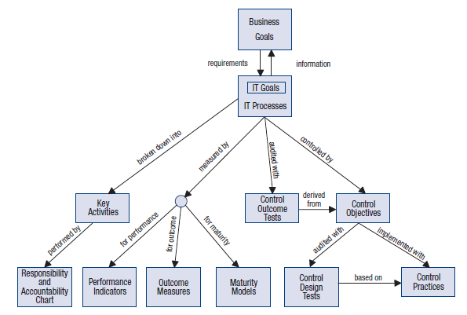
COBIT is a critical Resource for IT Auditors
The performance measurement ‘Monitor and Evaluate’ is, of course, of direct relevance to IT Auditors. The COBIT 4.1 publication provides a matrix which links generic business goals and IT goals and shows how they map to the information criteria and the COBIT domains and processes. See COBIT 4.1 publication, p.169
There are 17 business goals identified in 4 broad areas and 28 IT goals

Slide 57
COBIT 4.1 Processes
The COBIT framework is essentially a process-based model which is organised into four areas known as domains or groups of processes.
Each domain has a number of associated control processes and each process has related activities.
All of the processes and activities contribute in some way to seven information criteria - in COBIT terminology, a process is either a (P)Primary or (S)Secondary enabler to the criteria being met.

Slide 58
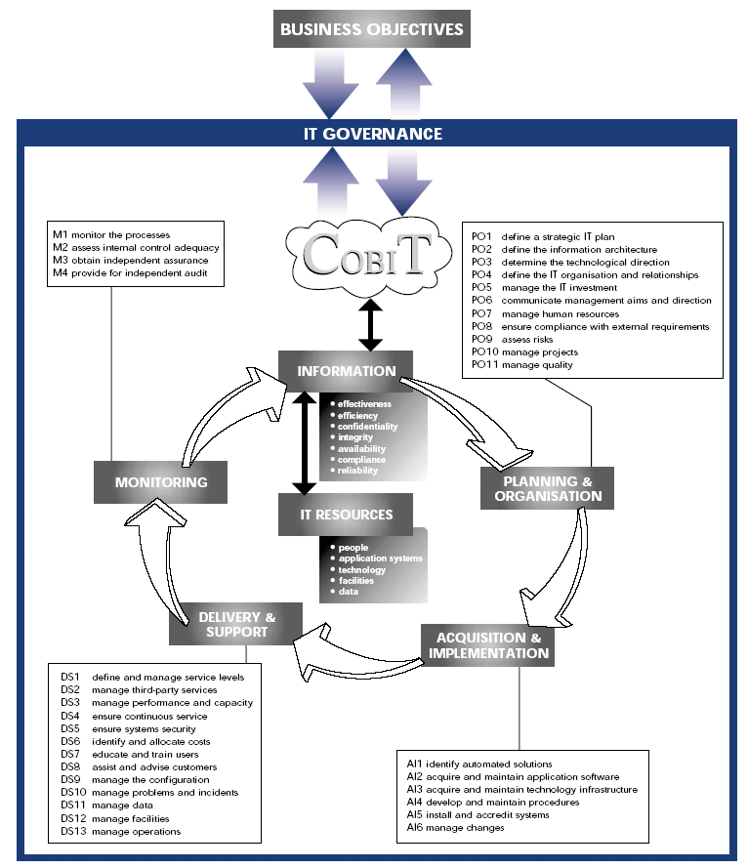
COBIT Process Model
Figure 3 Cobit Process Model

Slide 59
COBIT 4.1 Framework Key Control Criteria
The principle underpinning COBIT is that data stored in Information Systems must conform to seven key control criteria, which are described below:
Effectiveness - information must be relevant to the business process and available in a timely, accurate, consistent and usable fashion.
Efficiency - information should be provided by making the optimal (most productive and economical) use of resources.
Confidentiality - sensitive information must be protected from unauthorised disclosure. This is also a core principle of all Information Security Management frameworks e.g. ISO 27000 series.
Integrity - the information must be accurate, complete and valid. This is also a core principle of all Information Security Management frameworks e.g. ISO 27000 series.
Availability - the information must be available when required by the business. This area also concerns the safeguarding of necessary resources and associated capabilities. This is also a core principle of all Information Security Management frameworks e.g. ISO 27000 series.
Compliance - means that the information must comply with the laws, regulations and contractual arrangements to which the business process is subject, i.e., externally imposed business criteria as well as internal policies.
Reliability - relates to the provision of appropriate information for management to operate the entity and exercise its fiduciary and governance responsibilities

Slide 60
COBIT 4.1 Domains
Plan and Organise (PO) 10 control processes are in this domain - describes the enterprise’s IT processes and IT resources,, covering strategy and tactics. The way IT can contribute effectively to the achievement of the organisation’s business objectives is the realization of the strategic vision; which must be planned, communicated and managed
Acquire and Implement (AI) 7 control processes are in this domain - To realise the IT strategy, the IT solutions need to be identified, developed or acquired, as well as implemented and integrated into the business process. In addition, changes in, and maintenance of existing systems are covered by this domain to ensure that solutions continue to meet business objectives.
Deliver and Support (DS) 13 control processes. This domain is concerned with the delivery of IT services and this includes service delivery, management of security and continuity, service support for users, and management of data and operational facilities.
Monitor and Evaluate (ME) 4 control processes - All IT processes need to be regularly assessed over time for their quality and compliance with control requirements this domain addresses performance management, monitoring of internal control, regulatory compliance and governance.

Slide 61
Generic Control Requirements applicable to all COBIT 4.1
COBIT 4.1 guidance p. 14 states that:
“In addition to the specific process control objectives, each COBIT process has generic control requirements that are identified by PCn, for process control number.
PC1 Process Goals and Objectives - Define and communicate specific, measurable, actionable, realistic, results-oriented and timely (SMARRT) process goals and objectives for the effective execution of each IT process.
PC2 Process Ownership - Assign an owner for each IT process, and clearly define the roles and responsibilities of the process owner.
PC3 Process Repeatability - Design and establish each key IT process such that it is repeatable and consistently produces the expected results.
PC5 Policy, Plans and Procedures - Define and communicate how all policies, plans and procedures that drive an IT process are documented, reviewed, maintained, approved, stored, communicated and used for training.
PC6 Process Performance Improvement - Identify a set of metrics that provides insight into the outcomes and performance of the process

Slide 62
Generic Format of a Process Description in COBIT 4.1

Slide 63
Applicable COBIT 4.1 Process
Model for IT Auditors
In order to gain a better understanding of the COBIT process model, it is useful to consider the details of each process in the ‘Monitor and Evaluate’ domain since this domain is of particular interest to audit and assurance professionals. The processes associated with the domains are :
M1 – Monitor the processes
M2 – Assess internal control adequacy
M3 – Obtain independent assurance
M4 – Provide for independent audit

Slide 65
COBIT 5.0
Why the need for a new framework?
Notes:
Now a Holistic Framework

Slide 66
COBIT 5 Framework
Version 5 of this document was published in 2012 by the Information Systems Audit and Control Associations (ISACA).
COBIT 5 consolidates COBIT 4.1, Val IT and Risk IT into one complete framework, and has been updated to align with current best practices, e.g., ITIL V3 2011, TOGAF.
COBIT 5 builds on previous versions of COBIT (and Val IT and Risk IT), therefore organizations can build on what they have developed using earlier versions.
COBIT 5 is based on a revised process reference model with a new governance domain and several new and modified processes that now cover enterprise activities end-to-end, i.e., business and IT function areas
Notes:
What sort of framework is COBIT?
An IT audit and control framework?
COBIT (1996) and COBIT 2nd Edition (1998)
Focus on Control Objectives
An IT management framework?
COBIT 3rd Edition (2000)
Management Guidelines added
An IT governance framework?
COBIT 4.0 (2005) and COBIT 4.1 (2007)
Governance and compliance processes added
Assurance processes removed
BUT what is the difference between governance and management?

Slide 67
COBIT 5 is the latest edition of ISACA’s globally accepted framework, providing an end-to-end business view of the governance of enterprise IT that reflects the central role of information and technology in creating value for enterprises.

Slide 68
The principles, practices, analytical tools and models found in COBIT 5 embody thought leadership and guidance from business, IT and governance experts around the world.
COBIT 5 is the only business framework for the governance and management of enterprise IT.

Slide 69
This evolutionary version incorporates the latest thinking in enterprise governance and management techniques, and provides globally accepted principles, practices, analytical tools and models to help increase the trust in, and value from, information systems.

Slide 70
COBIT 5 builds and expands on COBIT 4.1 by integrating other major frameworks, standards and resources, including ISACA’s Val IT, Risk IT and BMIS. We have also aligned COBIT 5 with significant guidance and standards, including ITIL and ISO.

Slide 71
COBIT 5 – Now one Complete Framework
Governance of Enterprise IT
Evolution of scope
IT Governance
Val IT 2.0
(2008)
Management
Control
Risk IT
(2009)
Audit
COBIT1
COBIT2
COBIT3
COBIT4.0/4.1
COBIT 5
1996
1998
2000
2005/7
2012
An business framework from ISACA, at www.isaca.org/cobit

Slide 72
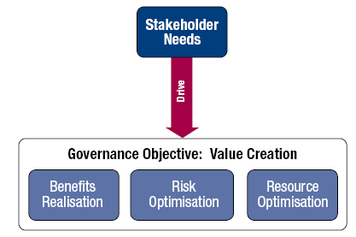
COBIT 5
Enterprises exist to create value for their stakeholders. Consequently, any enterprise— commercial or not—will have value creation as a governance objective.
Value creation means: Realising benefits at an optimal resource cost while optimising risk.
Source: COBIT® 5, figure 3. © 2012 ISACA® All rights reserved.

Slide 73
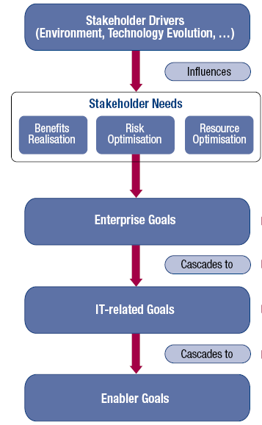
Stakeholder Value and Business Objectives
Principle 1. Meeting Stakeholder Needs:
Stakeholder needs have to be transformed into an enterprise’s actionable strategy.
The COBIT 5 goals cascade translates stakeholder needs into specific, practical and customised goals within the context of the enterprise, IT-related goals and enabler goals.
Source: COBIT® 5, figure 4. © 2012 ISACA® All rights reserved.
Notes:
The goals cascade is not ‘new’ to COBIT.
It was introduced in COBIT 4.0 in 2005.
Those COBIT users who have applied the thinking to their enterprises have found value.
BUT not everyone has recognized this value.
The goals cascade supports the COBIT 5 stakeholder needs principle that is fundamental to COBIT and has therefore been made prominent early in the COBIT 5 guidance.
The goals cascade has been revisited and updated for the COBIT 5 release

Slide 74
Stakeholder Value and Business Objectives
Stakeholder needs can be related to a set of generic enterprise goals. These enterprise goals have been developed using the Balanced Scorecard (BSC) dimensions. (Kaplan, Robert S.; Norton, David P.; The Balanced Scorecard: Translating Strategy into Action, Harvard University Press, USA, 1996)
The enterprise goals are a list of commonly used goals that an enterprise has defined for itself.
Although this list is not exhaustive, most enterprise-specific goals can be easily mapped onto one or more of the generic enterprise goals.

Slide 75
COBIT 5 DOMAINS
CobiT 5 has five domains under governance and management.
The governance section provides guidance on Evaluation, Direction and Monitoring of IT processes and is aligned with the ISO38500 standard for “standard for corporate governance of information technology.”
The four domains in the management area are:
Align, Plan and Organize
Build, Acquire and Implement
Deliver, Service and Support
Monitor, Evaluate and Assess

Slide 76
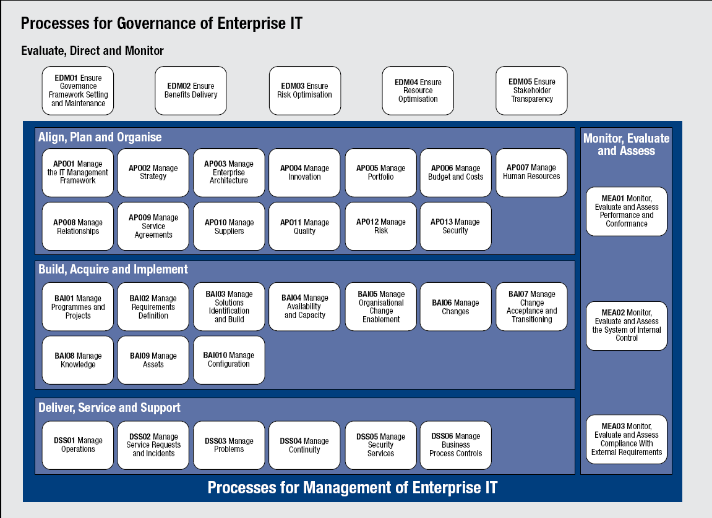
COBIT5 New Process Reference Model
Source: COBIT® 5, figure 16. © 2012 ISACA® All rights reserved.
Notes:
Governance ensures that stakeholder needs, conditions and options are evaluated to determine balanced, agreed-on enterprise objectives to be achieved; setting direction through prioritisation and decision making; and monitoring performance and compliance against agreed-on direction and objectives (EDM).
Management plans, builds, runs and monitors activities in alignment with the direction set by the governance body to achieve the enterprise objectives (PBRM).
There are several new and modified processes that reflect current thinking, in particular:
APO03 Manage enterprise architecture.
APO04 Manage innovation.
APO05 Manage portfolio.
APO06 Manage budget and costs.
APO08 Manage relationships.
APO13 Manage security.
BAI05 Manage organisational change enablement.
BAI08 Manage knowledge.
BAI09 Manage assets.
DSS05 Manage security service.
DSS06 Manage business process controls.

Slide 77
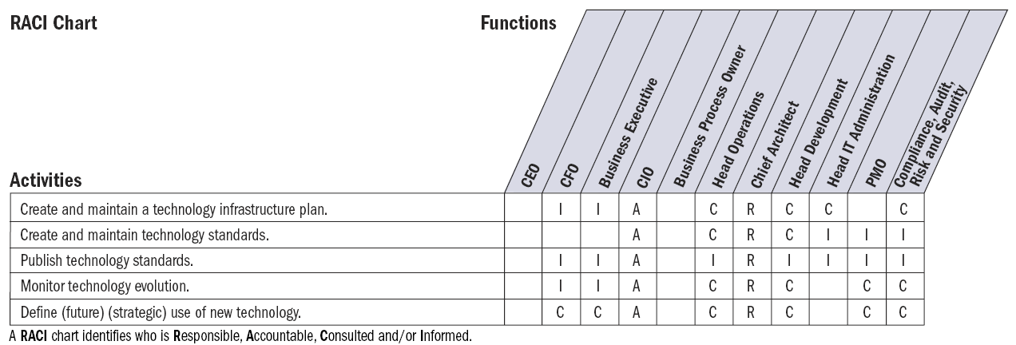
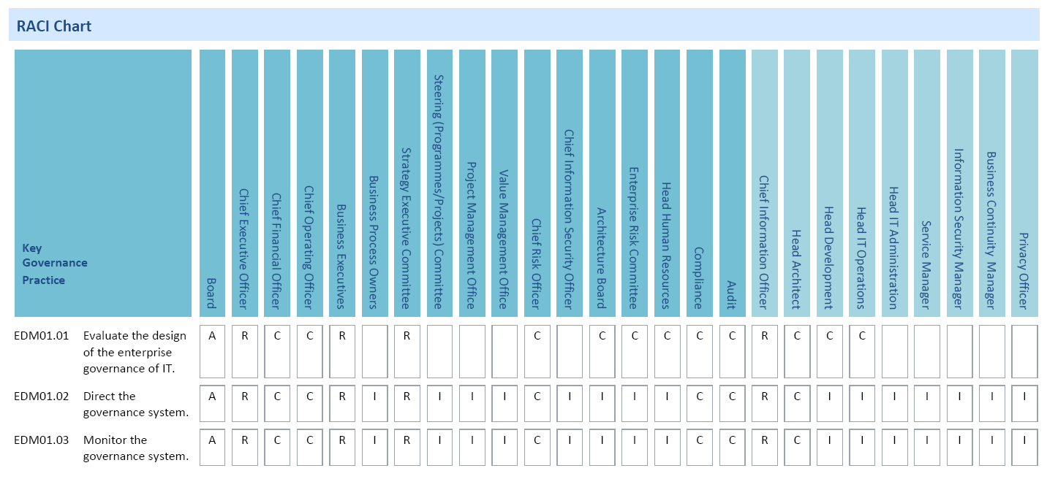
COBIT 4.1
Source: COBIT® 4.1, page 39. © 2007 IT Governance Institute® All rights reserved.
COBIT 5
Source: COBIT® 5: Enabling Processes, page 31. © 2012 ISACA® All rights reserved.

Slide 78
Using the Capability Maturity Model (CMM) for internal control
Every organisation needs to understand the ‘status’ of its own IT systems and to decide what level of management and control should be in place.
In taking this decision, Senior Management must take into consideration associated costs and potential benefits.
Some form of measurement is central to this process since organisations need to know where they are, where improvement is needed and how this improvement can be monitored.

Slide 79
Maturity Model Approach
The IT Assurance Guide Using COBIT - (‘Maturity Model for Internal Control’) provides a generic maturity model showing the status of the internal control environment and the establishment of internal controls in an enterprise. It shows how the management of internal control, and an awareness of the need to establish better internal controls, typically develops from an ad hoc to an optimized level. The model provides a high-level guide to help COBIT users appreciate what is required for effective internal controls in IT and to help position their enterprise on the maturity scale.
  0 Non-existent - There is no recognition of the need for internal controls.
  1 Initial/ad hoc - There is some recognition of the need for internal control
  2 Repeatable but Intuitive - Controls are in place but are not documented
  3 Defined - Controls are in place and adequately documented.
  4 Managed and Measurable - There is an effective internal control and risk management environment.
  5 Optimized - An enterprise-wide risk and control program provides continuous and effective control and risk issues resolution

Slide 80
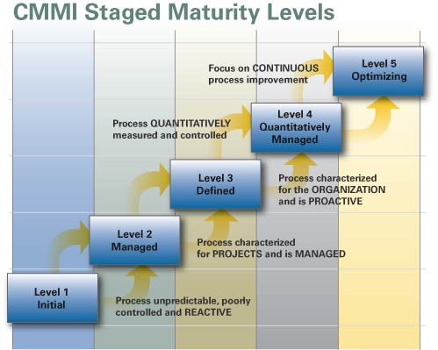

Slide 81
Process Capability Models and Assessments
COBIT 5 discontinues the COBIT 4.1, Val IT and Risk IT CMM-based capability maturity modelling approach.
COBIT 5 will be supported by a new process capability assessment approach based on ISO/IEC 15504, and the COBIT Assessment Programme has already been established. It replaces COBIT 4.1 CMM approach.
www.isaca.org/Knowledge-Center/cobit/Pages/COBIT-Assessment-Programme.aspx
The COBIT 4.1, Val IT and Risk IT CMM-based approaches are not considered compatible with the ISO/IEC 15504 approach because the methods use different attributes and measurement scales.

Slide 82
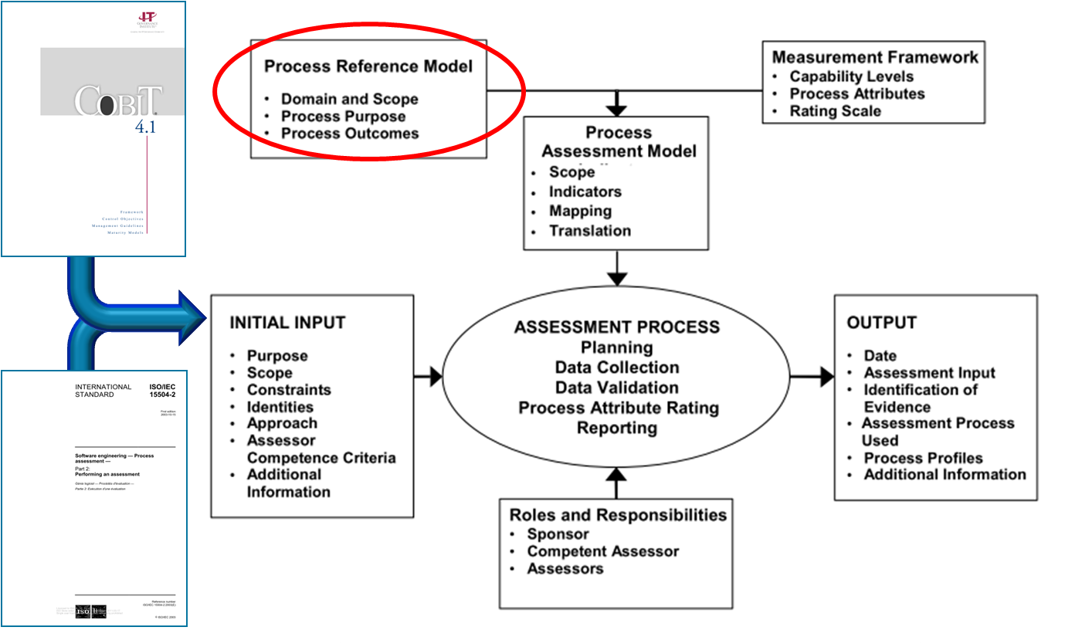
Process Capability Models and Assessments (cont.)
COBIT 4.1/5
© 2012 ISACA® All rights reserved.

Slide 83
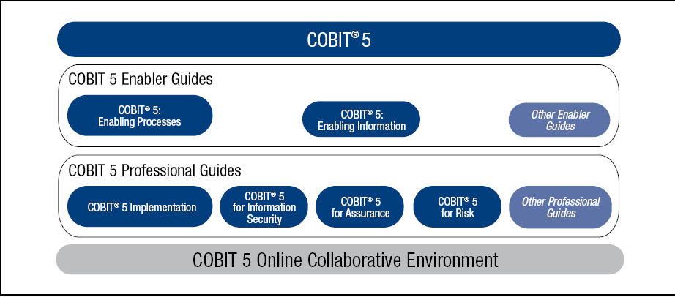
COBIT 5 Family
Source: COBIT® 5, figure 11. © 2012 ISACA® All rights reserved.
Notes:
FOCUS ON ENABLERS

Slide 84
ISO 27000 Standards for Information Security Management
An information security management system (ISMS) is a set of policies and procedures for systematically managing an organization's sensitive data. The goal of an ISMS is to minimize risk and ensure business continuty by pro-actively limiting the impact of a security breach

Slide 85
ISO 27000 Standards for Information Security Management
An ISMS typically addresses employee behavior and processes as well as data and technology. It can be targeted towards a particular type of data, such as customer data, or it can be implemented in a comprehensive way that becomes part of the company's culture.

Slide 86
ISO 27000 Standards for Information Security Management
The most important Information Security Management standards are the ISO 27000 series and the key ‘sub-set’ for IT Auditors in the 27000 series are ISO 27001 and 27002.
ISO 27001 is an excellent control framework for protection of information assets. ISO 27001 (its full title is actually ISO/IEC 27001:2013 an update from ISO 27001: 2005) forms the basis for an assessment of an organisation’s ISMS and can be used as a basis for a formal certification to the standard by external verifiers i.e. ISO 27001 is the control document against which an organisation’s ISMS is assessed.
ISO 27002 covers the control procedures and are very important for general and application controls.
Notes:
This is covered in detail in a later module

Slide 87
ISO 27000 Standards for Information Security Management
ISO 27001 is a specification for creating an ISMS. It does not mandate specific actions, but includes suggestions for documentation, internal audits, continual improvement, and corrective and preventive action.

Slide 88
ISO 22301 Business Continuity Management System (BCMS)
This is the world’s first international standard for Business Continuity Management (BCM) . It was developed to help organizations minimize the risk of business disruptions .
This standard currently replaces the current British standard BS 25999 and places greater emphasis on :
Setting the objectives, monitoring its performance and metrics.
Clearer expectations on management
More careful planning for and preparing resources needed for ensuring business continuity.

Slide 89
ISO 22301 Business Continuity Management System (BCMS)
Business Continuity (BC) is defined as the capability of the organization to continue delivery of products or services at acceptable predefined levels following a disruptive incident. (Source: ISO 22301:2012)

Slide 90
ISO 22301 Business Continuity Management System (BCMS)
Business Continuity Management (BCM) is defined as a holistic management process that identifies potential threats to an organization and the impacts to business operations those threats, if realized, might cause.

Slide 91
ISO 22301 Business Continuity Management System (BCMS)
This provides a framework for building organizational resilience with the capability of an effective response that safeguards the interests of its key stakeholders, reputation, brand and value-creating activities. (Source: ISO 22301:2012)

Slide 92
ITIL - IT Service Management
ITIL is the most widely accepted approach to IT service management in the world and provides a comprehensive set of best practice, drawn from the public and private sectors internationally. ITIL can help individuals and organizations use IT to realize business change, transformation and growth.
The ITIL processes within IT Service Management (ITSM) ensure that IT Services are provided in a focused, client-friendly and cost-optimized manner. With their help, IT Services are clearly defined, success can be measured with regards to the service provision, and targeted improvement measures can be introduced where necessary.
Notes:
It seeks to improve communications, streamline the request process and help your customers to understand and link the services you provide to business outcomes they care about. Because ITSM is driven both by technology and the huge range of organizational environments in which it operates, it is constantly evolving.
The ITIL framework will be covered in detail in the manual for the INTERMEDIATE level training - Module 11 ‘IT Service Delivery and Support using ITIL’.

Slide 93
The core ITIL guidance is based upon a lifecycle approach, and it consists of five publications, each represents a lifecycle stage:
ITIL Service Strategy
ITIL Service Design
ITIL Service Transition
ITIL Service Operation
ITIL Continual Service Improvement

Slide 94
Service Strategy Process Objective:
To decide on a strategy to serve customers. Starting from an assessment of customer needs and the market place, the Service Strategy process determines which services the IT organization is to offer and what capabilities need to be developed. Its ultimate goal is to make the IT organization think and act in a strategic manner.

Slide 95
Service Design Process Objective: To design new IT services. The scope of the process includes the design of new services, as well as changes and improvements to existing ones.

Slide 96
Service Transition Process Objective: To build and deploy IT services. Service Transition also makes sure that changes to services and Service Management processes are carried out in a coordinated way.

Slide 97
Service Operation Process Objective: To make sure that IT services are delivered effectively and efficiently. The Service Operation process includes fulfilling user requests, resolving service failures, fixing problems, as well as carrying out routine operational tasks.

Slide 98
Continual Service Improvement - CSI Process Objective: To use methods from quality management in order to learn from past successes and failures. The Continual Service Improvement process aims to continually improve the effectiveness and efficiency of IT processes and services, in line with the concept of continual improvement adopted in ISO 20000.

Slide 99
Best Practice’ for IT Project Management
Effective Programme and Project management methodologies are particularly important for IT programmes/projects since there is a long and impressive history of IT projects failing to deliver within budget/time/quality expectations!
The type of project management control environment offered by either PRINCE2 (Projects in a Controlled Environment) or PMBOK (Project Management Body of Knowledge) provide excellent control guidance for project organisation and planning, project execution, project closure, quality assurance, configuration management, risk management, change control and issue management for IT projects and programmes.
IT Auditors need to be aware of best practice in this area since, as indicated above, it is commonly reported throughout the professional literature that a poor or inadequate project management control environment is one of the main factors contributing to failure of IT projects.

Slide 100
Discussion
How IT Audit and Assurance standards can be implemented in the organization?

Slide 101
Implementation
To execute a risk based audit strategy in compliance with IS audit standards to ensure that key areas are audited.
- There must be knowledge of the IS Audit and assurrance standards and guidelines,knowledge of fundamental business processes,knowledge of the applicable laws and regulations,risk assessment concepts and tools and techniques in planning,examination,reporting and follow-up.

Slide 102
Implementation
In garnering the knowledge of fundamental business processes i.e(payroll,procurement,payables,receivable etc.)
- IS Auditing involves the assessment of IS related controls put in place to ensure the achievement of contol objectives.In understanding control objectives and identifying keycontrols

Slide 103
Implementation
COBIT provides a comprehensive control framework that can help the IS Auditor benchmark control objectives.

Slide 104
Implementation
To plan specific audits to determine whether information systems are protected, controlled and provide value to the organisation.
The ISO’s will provide relevant and appropriate guidance along with the IS audit assurance and guidelines.

Slide 105
Implementation
To conduct audits in accordance with IS Standards to achieve planned audit objectives.
To communicate audit results and make recommendations to key stakeholders through meetings and audit reports to promote change where necessary

Slide 106
Implementation
To conduct audit follow ups to determine whether appropriate actions have been taken by management in a timely manner.

Slide 107
Review
Professional Ethics
Key Standards
Best Practices

